Slide 1
6th IFIP International Internet of Things (IFIP-IoT) Conference, 2023
Dallas-Fort Worth Metroplex, Texas, USA
EHR Security and Privacy Aspects: A Systematic Review
Authors: Sourav Banerjee* Sudip Barik*, Debashis Das**, Uttam Ghosh***
Kalyani Government Engineering College, Kalyani, WB, India * Narula Institute of Technology, Kolkata, WB, India** Meharry Medical College, TN, USA***

Slide 2
Introduction and Motivation
Importance of Electronic Health Records (EHR)
Key aspects of EHR security and privacy
Legal and ethical issues surrounding EHRs.
Multi-disciplinary approach needed for EHR security and privacy.

Slide 3

Importance of EHRs in Modern Healthcare
Sensitivity of patient information in EHRs.
Highlighting the potential consequences of security breaches.
Patients' rights and healthcare providers’ responsibilities.
Fig. EHR Data

Slide 4
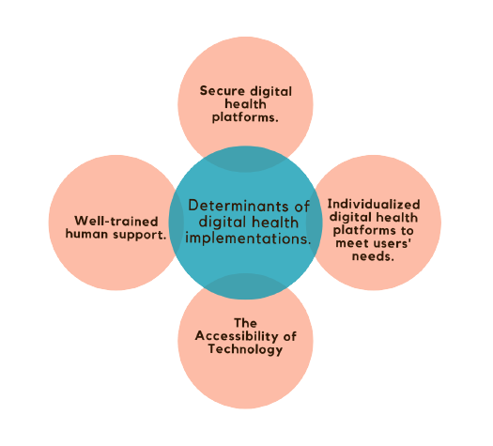
Digital Advancements in Healthcare
Role of digital technology in healthcare innovation.
Benefits and challenges.
Potential for cost savings and improved healthcare delivery.
Fig. The Key Factors Influencing Digital Health.

Slide 5
Major Challenges
Unauthorized access and cybersecurity threats.
Cybersecurity Threats
Data Breaches
Human Error
Interoperability Challenges
Legal Compliance
Patient Consent and Control

Slide 6
State of The Art
Access control
Encryption
Audit trails
Data minimization
Regular vulnerability assessments
Employee training and awareness
Compliance with regulations

Slide 7
Summary of Findings from Systematic Review
Ref. | Methods | Advantages | Limitations
2022 [1] | Homomorphic Encryption | By utilizing data aggregation, the EPPADA scheme aims to decrease energy usage by eliminating unnecessary data. | The plan entails utilizing intricate techniques for encrypting and decrypting data.
2022 [2] | A solution based on Elliptic Curve Cryptography | The suggested RPM system provides secure authentication via RFID, ensures secure communication, and protects privacy. | Challenges with dependability, restricted availability, and expensive communication.
2023 [3] | Federated Learning | FRESH uses certificate ring signatures as a source inference attack (SIA) defense. | The system being considered is susceptible to attacks through adversarial machine learning techniques.

Slide 8
Summary of Findings from Systematic Review
Ref. | Methods | Advantages | Limitations
2023 [4] | Cryptographic primitives designed for low computational and memory requirements are commonly referred to as lightweight. | The effectiveness of the proposed authentication technique is evaluated through security and performance analysis in comparison to established and widely-used schemes. | Challenges of dependability, restricted availability, and expensive communication
2023 [5] | Data aggregation | Compared to traditional methods, it lowers both the expense of communication and computation. | The absence of practical application in actual situations.
2023 [6] | Blockchain-based solution | The suggested solution protects user data privacy and enables information sharing across devices using blockchain and zero-knowledge evidence. | The inherent properties of blockchain technology may impose limitations on the system's ability to scale.

Slide 9
Limitations
Limited scope
Lack of real-world data
Small sample sizes
Limited diversity
Limited longitudinal data
Lack of standardized evaluation methods

Slide 10
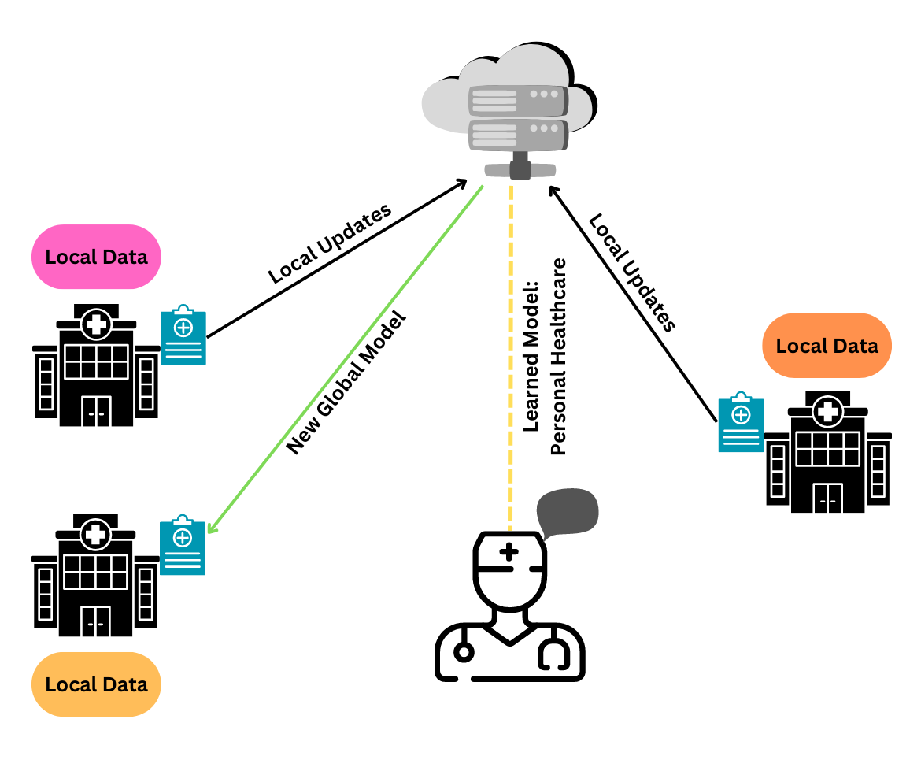
Federated Learning in Healthcare
Secure and Privacy-Focused Approach
IoMT Integration
Local Data Storage
Improved Prediction Accuracy
Privacy and Security
Fig. Federated Learning used in healthcare industry

Slide 11
Future Research
Advancing Privacy and Security in the Healthcare Industry
Study of the impacts of digitization on health outcomes
Exploring the Potential of Blockchain Technology in Healthcare
Future efforts in the healthcare sector are focused on enhancing Electronic Health Record (EHR) security. Novel approaches that leverage IoMT and blockchain technology are being explored to ensure concise and secure record-keeping in electronic mode.

Slide 12
Conclusion
Digitalization Benefits.
Consideration of Factors.
Potential Challenges.
Improved Patient Care and Cost Savings.

Slide 13
Refferences
Alam, M.A., Al Riyami, K.: Shear strengthening of reinforced concrete beam using natural fibre reinforced polymer laminates. Construction and Building Materials 162, 683–696 (2022)
Ahmed, M.I., Kannan, G.: Secure and lightweight privacy preserving internet of things integration for remote patient monitoring. Journal of King Saud University-Computer and Information Sciences 34(9), 6895–6908 (2022)
Wang, W., Li, X., Qiu, X., Zhang, X., Zhao, J., Brusic, V.: A privacy preserving framework for federated learningin smart healthcare systems. Information Processing & Management 60(1), 103167 (2023)

Slide 14
Refferences
Das, S., Namasudra, S.: Lightweight and efficient scpprivacy-preserving/scp mutual authentication scheme to secure scpinternet of things/scp-based smart healthcare. Transactions on Emerging Telecommunications Technologies (Jan 2023).
Bhowmik, T., Banerjee, I.: Eeppda—edge-enabled efficient privacy-preserving data aggregation in smart healthcare internet of things network. International Journal of Network Management p. e2216 (2023)
Singh, R., Dwivedi, A.D., Srivastava, G., Chatterjee, P., Lin, J.C.W.: A privacy preserving internet of things smart healthcare financial system. IEEE Internet of Things Journal (2023)

Slide 15
Thank You

